Slide 1

< React.js />
jit.team 2019

Slide 2

React is a declarative, efficient, and flexible JavaScript library
for building user interfaces. It lets you compose complex UIs from small and isolated pieces of code called “components”.
reactjs.org
jit.team 2019

Slide 3
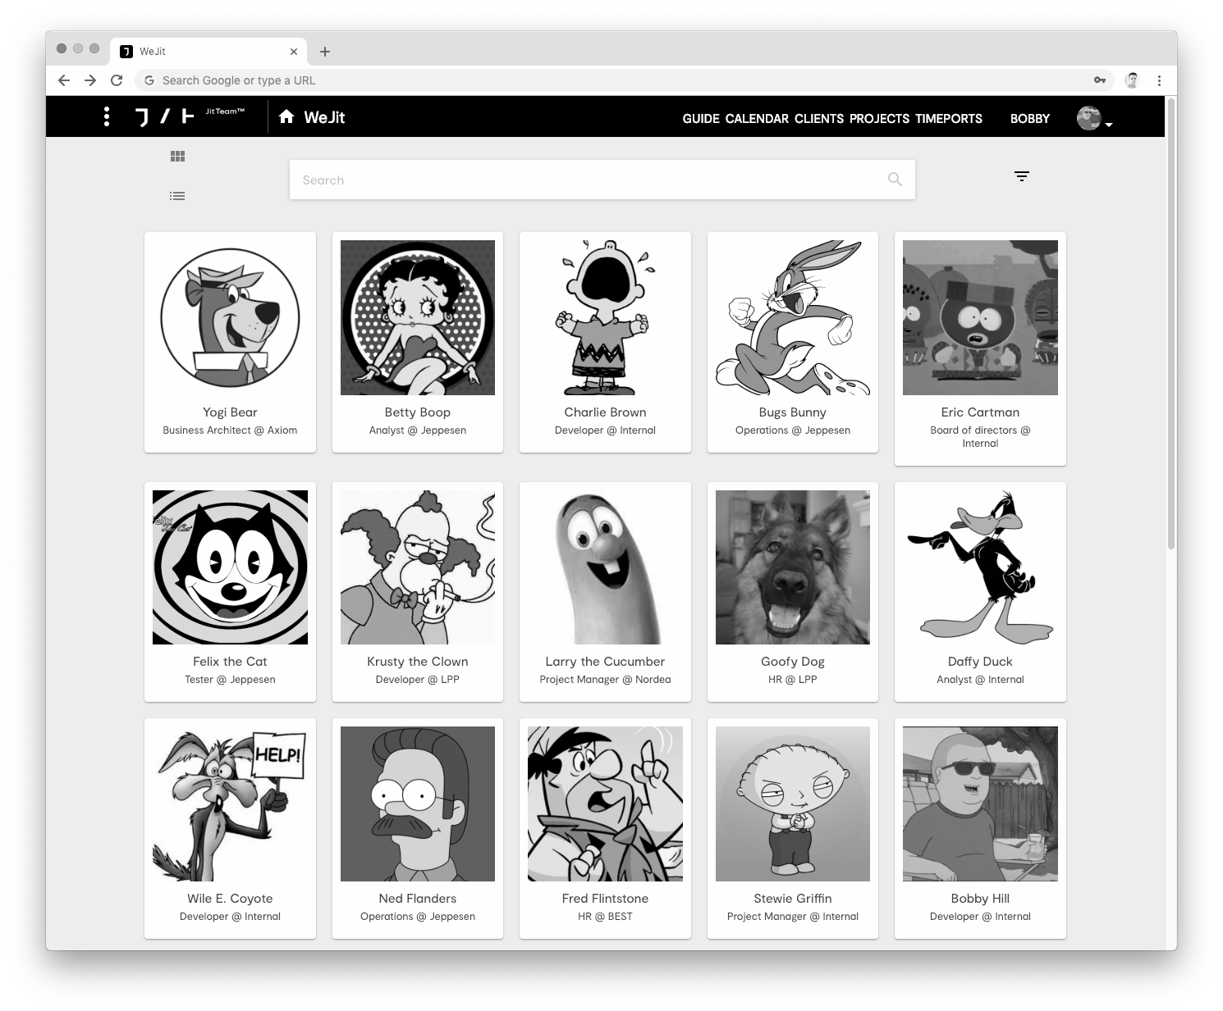
Components
Main
﹂
Header
Logo
﹂
UserList
﹂
﹂
UserItem
jit.team 2019

Slide 4
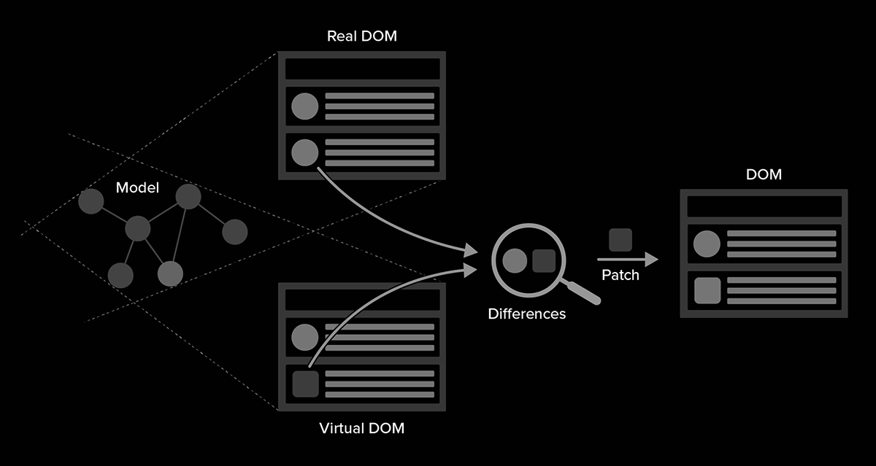
Virtual DOM
jit.team 2019
Notes:
Virtual DOM is abstraction of the HTML DOM - is better to think about virtual DOM as React’s local and simplified copy of the HTML DOM. React renders React Elements every virtual DOM object gets update React compares the virtual DOM with version of virtual DOM before update (diffing) React update real DOM for only those objects which are changed in virtual DOM Elements are light, statesless, immutable, virtual representation of a DOM Element. Elements describe what we want to see on the screen, they are the smallest building blocks of React apps. Unlike browser DOM elements, React elements are plain objects, and are cheap to create. React DOM takes care of updating the DOM to match the React elements.

Slide 5
JSX
Syntax extension not required
HTML + JavaScript
markup + logic
jit.team 2019
Notes:
JSX is syntax extension to JS, JSX may remind template language, but is comes with the full power of JS, Earlier we were separating markup and logic in separate files, in React we separate view/logic in units called Components, which contains both: HTML + JS = JSX JSX is closer to JS than HTML, so React DOM uses camelCase property naming convention instead of HTML attribute names, class className.

Slide 6
JSX examples
const name = ‘3LO’; const element = <h1>Hello, {name}</h1>;
const element = <img src={user.avatarUrl} />
jit.team 2019
Notes:
JSX is syntax extension to JS, JSX may remind template language, but is comes with the full power of JS, Earlier we were separating markup and logic in separate files, in React we separate view/logic in units called Components, which contains both: HTML + JS = JSX JSX is closer to JS than HTML, so React DOM uses camelCase property naming convention instead of HTML attribute names, class className.

Slide 7
JSX element
const element = ( <h1 className="greeting"> Hello, world! </h1> );
const element = React.createElement( 'h1', {className: 'greeting'}, 'Hello, world!' );
=
// Note: this structure is simplified const element = { type: 'h1', props: { className: 'greeting', children: 'Hello, world!' } };
jit.team 2019

Slide 8
JSX rendering
ReactDOM.render( element, document.getElementById('root') );
jit.team 2019

Slide 9
JSX updating
function tick() { const element = ( <div> <h1>Hello, world!</h1> <h2>It is {new Date().toLocaleTimeString()}.</h2> </div> ); ReactDOM.render(element, document.getElementById('root')); } setInterval(tick, 1000);
React Only Updates What’s Necessary
jit.team 2019

Slide 10
Components
user-defined component
ES6
function Welcome() { return <h1>Hello, 3LO</h1>; }
class Welcome extends React.Component { render() { return <h1>Hello, 3LO</h1>; } }
=
function component
class component
jit.team 2019

Slide 11
Function component
We call ReactDOM.render() with the <Welcome/> element.
React calls the Welcome component.
Our Welcome component returns a <h1>Hello, 3LO</h1> element as the result.
React DOM efficiently updates the DOM to match <h1>Hello, 3LO</h1>.
function Welcome() { return <h1>Hello, 3LO</h1>; } const element = <Welcome/>;
ReactDOM.render( element, document.getElementById('root') );
jit.team 2019

Slide 12
Class component
class component
function component
class Welcome extends React.Component { render() { return ( <div> <h1>Hello, 3LO!</h1> </div> ); } } ReactDOM.render( <Welcome/>, document.getElementById('root') );
function Welcome() { return <h1>Hello, 3LO</h1>; } const element = <Welcome/>;
ReactDOM.render( element, document.getElementById('root') );
jit.team 2019

Slide 13
Props
class Clock extends React.Component { render() { return ( <div> <h1>Hello, 3LO!</h1> <h2>It is {this.props.date.toLocaleTimeString()}.</h2> </div> ); } } ReactDOM.render( <Clock date={new Date()} />, document.getElementById('root') );
jit.team 2019

Slide 14
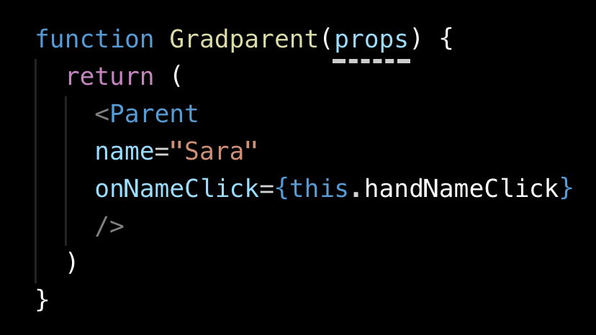
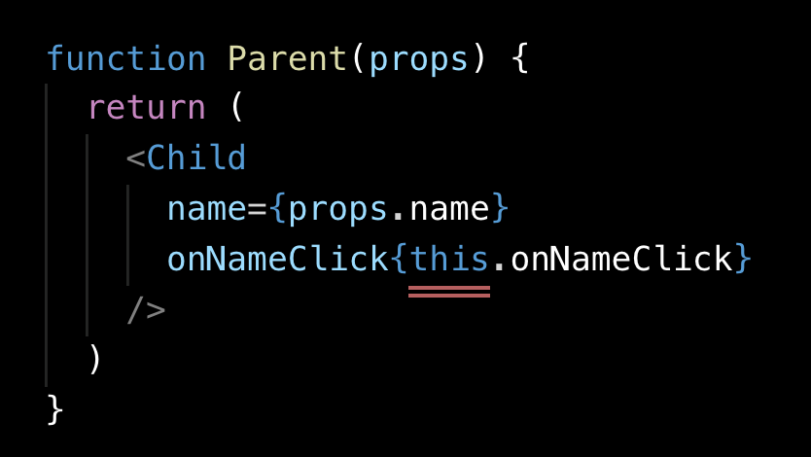
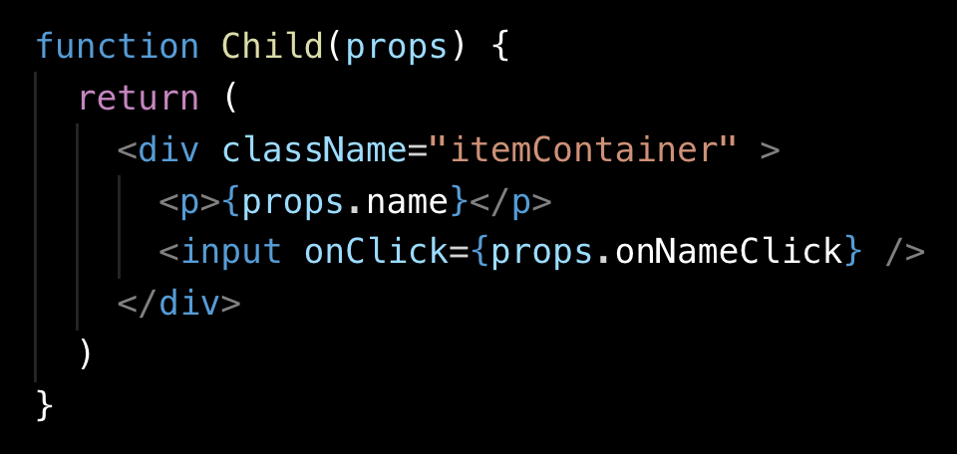
Events flows up
Data flows down
jit.team 2019

Slide 15
State
class Clock extends React.Component { constructor(props) { super(props); this.state = {date: new Date()}; } render() { return ( <div> <h1>Hello, world!</h1> <h2>It is {this.state.date.toLocaleTimeString()}.</h2> </div> ); } }
jit.team 2019
Notes:
State is similar to props, but it is private and fully controlled by the component. State allows React components to change their output over time in response to user actions, network responses, and anything else, without violating rule of not modifying component props. If we want to use state in our component we must convert it from function component to class component.

Slide 16
setState( )
this.state.comment = 'Hello';
wrong
this.setState({comment: 'Hello'});
correct
jit.team 2019

Slide 17
ES6 arrow functions
( parameters ) => { statement }
Shorter syntax
No binding of this
jit.team 2019

Slide 18
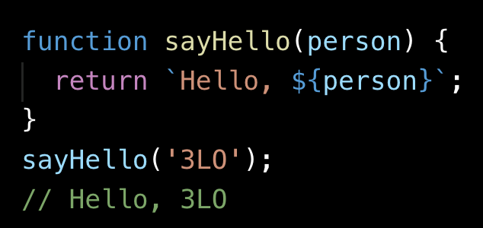
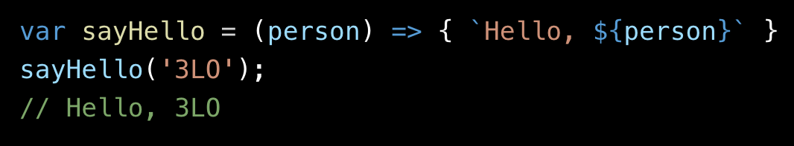
ES6 arrow functions
Shorter syntax
jit.team 2019

Slide 19
ES6 arrow functions
No binding of this
=
jit.team 2019

Slide 20
Handling Events
function ActionLink() { function handleClick(e) { e.preventDefault(); console.log('The link was clicked.'); } return ( <a href="#" onClick={handleClick}> Click me </a> ); }
HTML
<a href="#" onclick="console.log('The link was clicked.'); return false"> Click me </a>
addEventListener?
REACT
jit.team 2019

Slide 21
Handling Events bind
class Toggle extends React.Component { constructor(props) { super(props); this.state = {isToggleOn: true}; this.handleClick = this.handleClick.bind(this); } handleClick() { this.setState(state => ({ isToggleOn: !state.isToggleOn })); } render() { return ( <button onClick={this.handleClick}> {this.state.isToggleOn ? 'ON' : 'OFF'} </button> ); } }
jit.team 2019

Slide 22
Handling Events class fields
class LoggingButton extends React.Component { handleClick = () => { console.log('this is:', this); } render() { return ( <button onClick={this.handleClick}> Click me </button> ); } }
class LoggingButton extends React.Component { handleClick() { console.log('this is:', this); } render() { return ( <button onClick={(e) => this.handleClick(e)}> Click me </button> ); } }
=
jit.team 2019

Slide 23
Lists & Keys
function NumberList(props) { const numbers = props.numbers; const listItems = numbers.map((number) => <li key={number.toString()}> {number} </li> ); return ( <ul>{listItems}</ul> ); } const numbers = [1, 2, 3, 4, 5]; ReactDOM.render( <NumberList numbers={numbers} />, document.getElementById('root') );
MAP
const numbers = [1, 2, 3, 4, 5]; const listItems = numbers.map((number) => <li>{number}</li> );
RENDER
ReactDOM.render( <ul>{listItems}</ul>, document.getElementById('root') );
jit.team 2019

Slide 24
Forms
class NameForm extends React.Component { constructor(props) { super(props); this.state = {value: ''}; this.handleChange = this.handleChange.bind(this); this.handleSubmit = this.handleSubmit.bind(this); } handleChange(event) { this.setState({value: event.target.value}); } handleSubmit(event) {
alert('An essay was submitted: ' + this.state.value); event.preventDefault(); } render() { return ( <form onSubmit={this.handleSubmit}> <label> Name: <input type="text" value={this.state.value} onChange={this.handleChange} /> </label> <input type="submit" value="Submit" /> </form> ); } }
type
value
onChange
onSubmit
checked
selected
jit.team 2019

Slide 25
Lifecycle methods
class Clock extends React.Component { constructor(props) { ... } componentDidMount() { this.timerID = setInterval( () => this.tick(), 1000 ); } componentWillUnmount() { clearInterval(this.timerID); } tick() { this.setState({ date: new Date() }); } render() { ...
} }
Mounting
constructor() static getDerivedStateFromProps() render() componentDidMount()
Updating
static getDerivedStateFromProps() shouldComponentUpdate() render() getSnapshotBeforeUpdate() componentDidUpdate()
Unmounting
componentWillUnmount()
Error Handling
static getDerivedStateFromError() componentDidCatch()
jit.team 2019

Slide 26
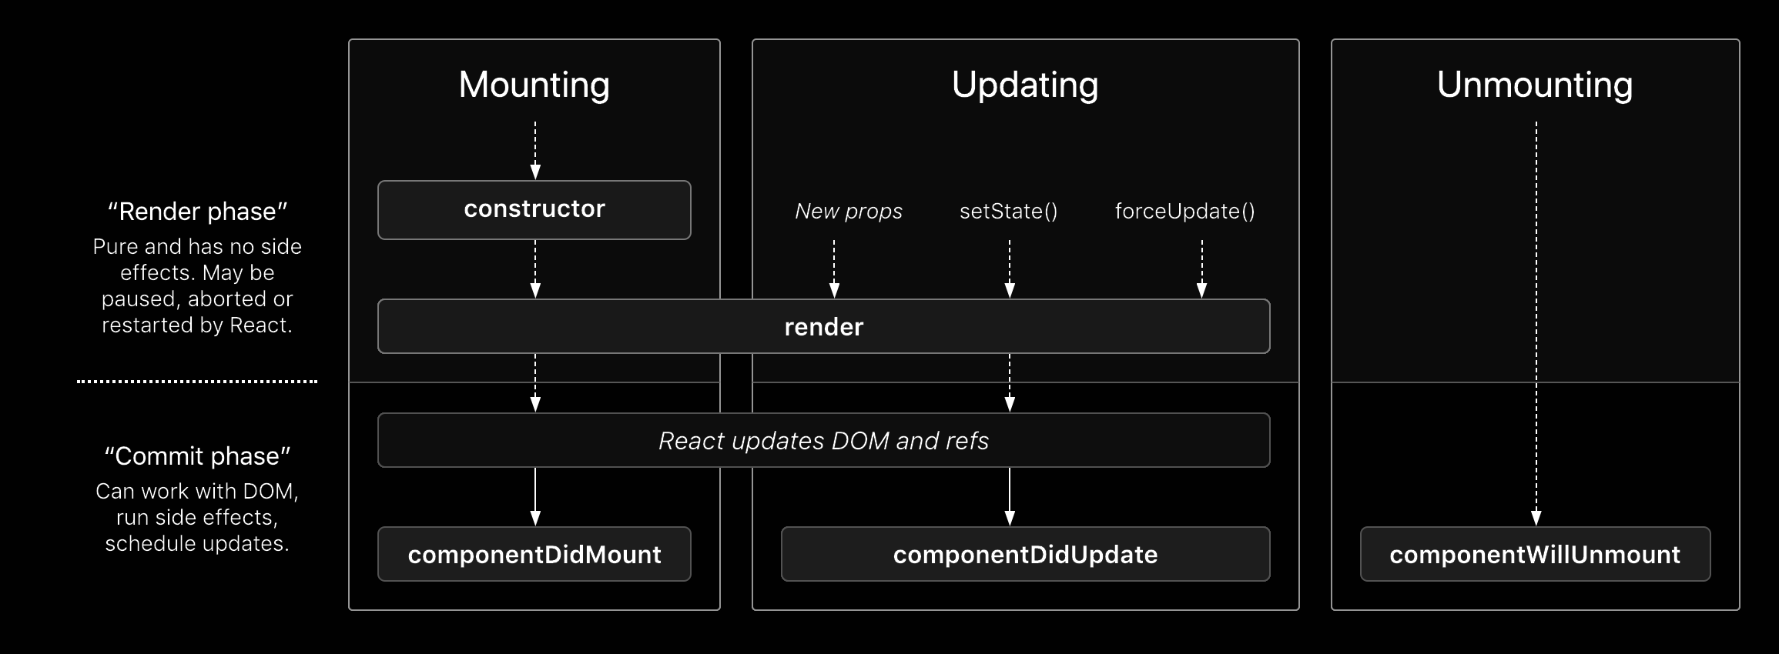
Lifecycle methods
jit.team 2019

Slide 27
Conditional rendering
If statement
render() { const isLoggedIn = this.state.isLoggedIn; let button; if (isLoggedIn) { button = <LogoutButton onClick={this.handleLogoutClick} />; } else { button = <LoginButton onClick={this.handleLoginClick} />; } return ( <div> <Greeting isLoggedIn={isLoggedIn} /> {button} </div> ); }
jit.team 2019

Slide 28
Conditional rendering
Logical && Operator
function Mailbox(props) { const unreadMessages = props.unreadMessages; return ( <div> <h1>Hello!</h1> {unreadMessages.length > 0 && <h2> You have {unreadMessages.length} unread messages. </h2> } </div> ); }
jit.team 2019

Slide 29
Conditional rendering
Conditional Operator
condition ? true : false.
render() { const isLoggedIn = this.state.isLoggedIn; return ( <div> {isLoggedIn ? ( <LogoutButton onClick={this.handleLogoutClick} /> ) : ( <LoginButton onClick={this.handleLoginClick} /> )} </div> ); }
render() { const isLoggedIn = this.state.isLoggedIn; return ( <div> The user is <b>{isLoggedIn ? 'currently' : 'not'}</b> logged in. </div> ); }
jit.team 2019

Slide 30
Toolchain
Kind | Tools | Task
Package Manager | Yarn, npm | It lets you take advantage of a vast ecosystem of third-party packages, and easily install or update them.
Bundler | Webpack, Parcel | It lets you write modular code and bundle it together into small packages to optimize load time.
Compiler | Babel | It lets you write modern JavaScript code that still works in older browsers.
jit.team 2019
Notes:
A JavaScript build toolchain typically consists of: A package manager, such as Yarn or npm. It lets you take advantage of a vast ecosystem of third-party packages, and easily install or update them. A bundler, such as webpack or Parcel. It lets you write modular code and bundle it together into small packages to optimize load time. A compiler such as Babel. It lets you write modern JavaScript code that still works in older browsers. If you prefer to set up your own JavaScript toolchain from scratch, check out this guide that re-creates some of the Create React App functionality. Don’t forget to ensure your custom toolchain is correctly set up for production.

Slide 31
npm examples
npm init
npm install npm@latest -g
npm install --save-dev webpack@4.19.1
https://docs.npmjs.com/
jit.team 2019

Slide 32
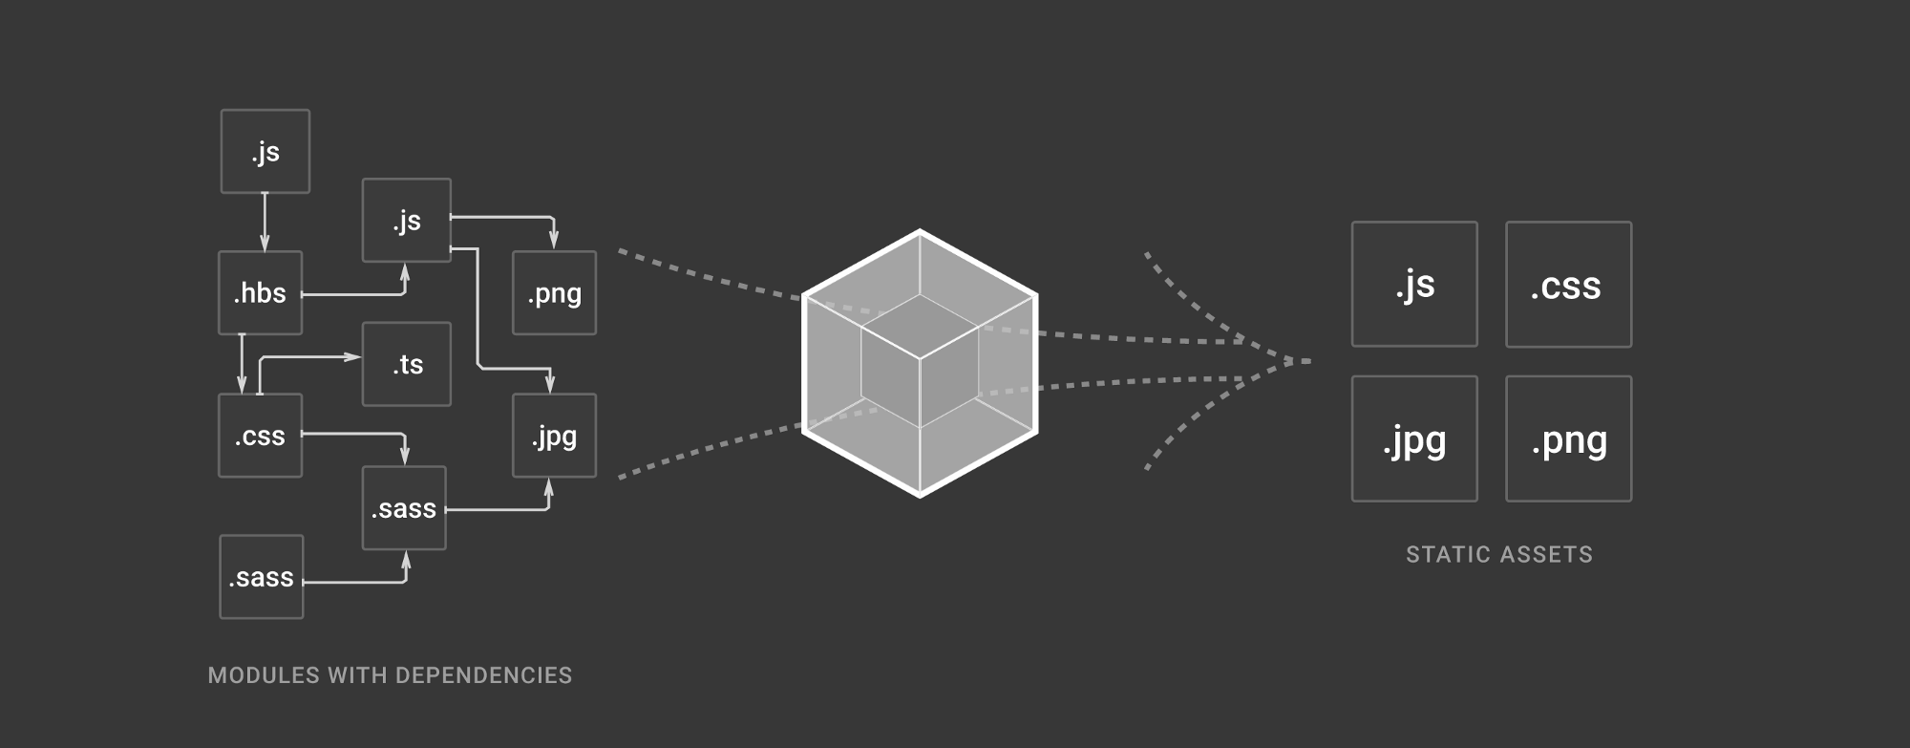
Webpack
https://webpack.js.org/
jit.team 2019

Slide 33
Babel
IN
// ES2015 arrow function
[1, 2, 3].map((n) => n + 1);
[1, 2, 3].map(function(n) { return n + 1; });
OUT
https://babeljs.io/
jit.team 2019

Slide 34
New app
node.js + npm https://nodejs.org/en/download/
npx create-react-app my-app
cd my-app
/
Development
Production
npm start
npm run build
jit.team 2019

Slide 35
Workshop #1
Tic-tac-toe
game
jit.team 2019

Slide 36
Homework #1
Postcard app
reactivation
https://github.com/mackankowski/frontend-bootcamp/tree/master/playground/react/postcard-app
jit.team 2019

